Slide 1
Henry VIII the Life Behind the Villain
BY Harry Long

Slide 2
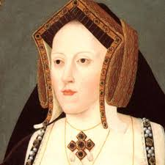
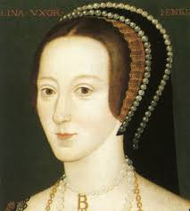
Once upon a time
There lived a man called Henry the VIII he was a cruel husband, he had 2 of his wives divorced 2 of them were beheaded 1 of them died; the other one he never saw again because he died. So he had 6 wives. He even built his own huge church just so he could divorce his first wife Catherine of Aragon.
Catherine of Aragon had been through a lot. Her first husband was Henry VIII’s brother Arthur but he died and Catherine became Henry VIII’s wife. Now, because Arthur died that meant that Henry was now the untrained King. The job of King was to make sure England had a King after he died. Queens weren’t as appreciated because at the time people lived in an unfair society. This was because men were thought of the superior people because they were physically stronger – that’s cruel! So having a male heir was very important. Anyway, his first child was a girl and she was named Mary and later went on to become queen of England. Henry (being the fussy person he was) was furious that he didn’t have a male heir, he got cross just because he had a child. He got so cross that he demanded the church (because the church was powerful like the government) for a divorce, but the Roman Catholic Pope declined to agree to it. Henry was a stubborn fellow and so he created his own church and religion and named it the Church of England. He divorced Catherine of Aragon so he could moved on.
His next wife was Anne Boleyn. Anne Boleyn promised to give Henry a male heir, so he married her. Secretly Anne only wanted the power of being queen, and because Henry was so daft he didn’t realise it. In the end Henry VIII called her a witch because she had eleven fingers and 3 nipples! He also thought that her 4 brothers could be responsible for her weird differences. So when he had Anne Boleyn killed he also had her 4 innocent brothers murdered as well. Furthermore, he didn’t even turn up to her execution, he just played badminton with his friends instead! She also didn’t provide a male heir, instead she gave birth to Elizabeth I.

Slide 3
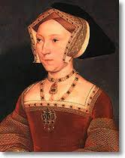
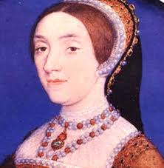
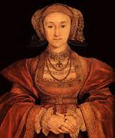

After his second failure in having a male heir, he married Jane Seymour. Jane was a beautiful woman that was kind and caring, and what differs her to his other two wives, is that Henry actually likes Jane, and when he gets a boy (Edward VI) he is delighted. However, Jane sadly dies during child birth and Henry goes back to wanting another wife.
His fourth wife was Anne of Cleaves a German duchess. He is shown a beautiful picture of her and he immediately wants to marry her, only to find that when he meets her he thinks that she looks like a horse! Yes, that’s right Henry VIII regrets this early marriage straight away and divorces her. He even goes on to call her a Flanders mare (mare meaning horse).
Kathryn Howard became Henry’s fifth wife only 16 days after he divorced Anne of Cleaves. Kathryn who was young and beautiful brought joy to the kings life, since he was already suffering from a jousting injury in his leg. He was gaining a lot of weight and his life as a sporty person was no more. Shorter than a year later a rumour spread that Kathryn was in love with another person of her own age. In the month of November on the year 1541 there was plenty of evidence and the Archbishop Cranmer informed the King with this rumour and the evidence. Henry had her meet the same fate as her cousin Anne Boleyn - off with her head!
Catherine of Parr was Henry’s last wife, Catherine did all the work for him (even though he was already getting all of his work done for him, but that’s later on in the book!) Henry had recently been suffering from an injury he got whilst jousting and he his blood pipes were getting blocked because of the unhealthily diet he ate. He was getting fatter and fatter each day one day he was lying in his bed and he died. His body was slowly dying and there was no way to stop it, it was going to happen. He ate too much and killed himself !

Slide 4
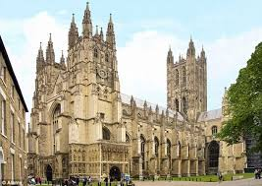

Henry’s religion was very mixed. He was originally a very strong Roman Catholic and didn’t like the protestants. But a rule about being a part of the roman catholic church is that you can’t divorce after you’ve married. After his first marriage with him and Catherine of Aragon he wanted a divorce he went to the church and demanded a divorce. The kept saying no, in the end Henry annoyed the church so much that they excommunicated (chucked him out) of the church. Henry then built his own church – the church of England. He made his own rules according to what he wanted. Now, the countries religion was decided by what the King believed in. So by turning his own religion to Protestant he turned the whole country Protestant. He then decided that he would burn down any remaining Catholic churches or monasteries. After he burned them down he claimed the land for himself! He was a ruthless protestant King and killed 72,000 people.
Some of which were the strong Catholics, others were peasants, lords and other high classed people of society. Whilst he lay on his death bed he turned the country back to Catholic. He brought them back to the religion that had nothing in the country he ruled! He had taken all of their land, and burned down all the building and properties of the Roman Catholic religion. This wasn’t good for country as now their chosen belief was weak and their next King was also weak leaving the country very much powerless.
When the English church was created Henry carried on using the methods of tithe (tax) and the English church focused on a particular payment called Mortuary Payment. The amount of money which the person in question would give to the church for the allowance to be buried after their death. This was demanded from the richest of people to poorest. Going back to the fact that Henry made the whole country his religion because he was the King meant that in the Mortuary Payment circumstances, every person would have to pay.

Slide 5
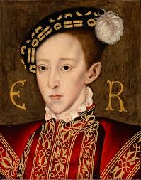
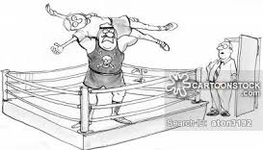
Henry was obsessed with having a male heir that would success him once he died. In the end, his third wife - Jane Seymour gave birth to Edward VI but Edward was a very young King when he came to power and wasn’t ready. He was still in school whilst he was King! Mary, Henry’s first child was ruthless killing many protestants (since she was a catholic). However, Elizabeth the first was a great queen despite killing several people in her life.
Another thing Henry was obsessed about was parties and sports. Instead of peacefully negotiating with other leaders of powerful countries he would wrestle them and joust with them. His love of sports lead him to an injury that happened around the time of Anne of Cleaves and Kathryn Howard. As his brother Arthur was meant for the throne Henry never prepared to be King as a child. When Henry became king he hired people to do his royal paperwork duties instead of doing it himself (lazy!)

Slide 6
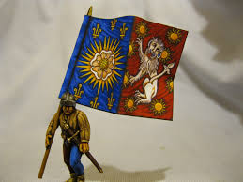
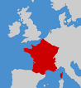
Henry had a very firm rule over England.
After his brother Arthur died, he became the heir to the throne of England, something he never expected. When he became King he was very wary that other people might have a stronger claim to the throne than him. The Yorkist side of his family, or people related to the them might have wanted to go back to the branch of the family descended from Edward III. So when Henry heard someone claim that they deserved the throne or a rumour that someone said they had a stronger claim to the throne, Henry would deal with it immediately and suspected traitor would be executed.
Thomas Cromwell was a very loyal servant of Henry. He ran the government for him and gave Henry lots of money through his great work. Thomas did so well, that Henry rewarded him by making him the Earl of Essex. However, Cromwell was responsible for the embarrassing marriage to Anne of Cleaves, and Henry was so angry he had him executed.
He also ruined the 60 years of peace. For it had been 60 years since England’s last battle on the continent. In the month of February 1512 Henry had the parliament supply the necessary grants and propaganda against the Kings of both Scotland and France. And so England went to war against France. No war was declared against Scotland but the northern border did not remain quiet.
Henry had a great system of courts in place. These courts were controlled by the bishops, officials and archdeacons. After the dissolution of the Roman Catholic church there was the added bonus that all the churchmen were now working for him.

Slide 7
Sources:
Wikipedia.org
Activehistory.co.uk
Tudorhistory.org
England under the Tudors, GR Elton, Methuen 1985

