Slide 1
5 Elements
By Harry long

Slide 2
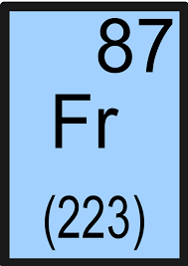
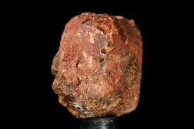
Francium
Francium
www.windowssearch-exp.com
Francium is the most unstable metal in the first 101 elements
It has a melting point of 27° and a boiling point of 678.6°.
You can make artificial Francium by bombarding thorium with protons.
It is found in uranium minerals.
It was discovered by Marguerite Perey in 1939.
It was predicted to exist in the 1840’s by someone called Meedeleev.
Marguerite found Francium when she was decaying Actium, she noticed there was a product being formed from it’s decay – this was Francium.
Marguerite named Francium after the country she came from which was France.
Francium atoms have 87 electrons.
Francium is so radioactive, that any amount formed could decompose other elements.
Francium as a metal -Wikipedia.org
Francium as a rock –emaze.com

Slide 3
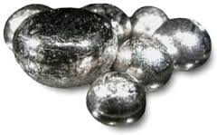
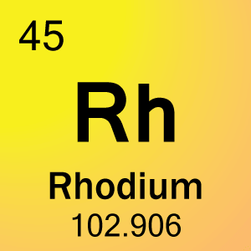
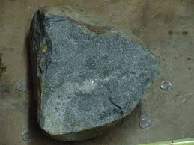
Rhodium
Rhodium
Sciencenotes.org
It is a member of the platinum group.
It is one the rarest and most valuable precious metals.
It discovered in 1803 by William Hyde Wollaston.
The word Rhodium comes from the Greek word Rhodon.
It was first discovered in crude platinum ore.
Wollaston also discovered palladium.
It is a silvery white colour and is very reflective, hard and durable.
It has a low electrical resistance.
It is very resistant against corrosion.
Rhodium is only ever found in small quantities.
It is use as an alloy, to create platinum and palladium stronger.
It has a melting point of 1,964°
It has a boiling point of 3,695°
Rhodium as a metal -Wikipedia.org
Rhodium as a rock

Slide 4
Platinum
Platinum comes from the Spanish word Platina meaning silver.
It can absorb large amounts of hydrogen.
Platinum can be combined with cobalt to make very strong magnets.
It was discovered by pre-Columbian Americans to create artefacts.
It has a melting point of 1,768°
It has a boiling point of 3,825°
International prototype for the first kilogram was made out of Platinum and Iridium.
Platinum very easy to shape.

Slide 5
Chromium
Chromium has a melting point of 1,901°
Chromium has a boiling point of 2,671°
The name “Chromium” comes from the Greek word Chroma meaning colour.
Chromium was discovered in 1797 by Louis Nicolas Vauquelin.
Chromium has a steel like colour.
Chromium is a hard metal.
It has many compounds that are all coloured.
Chromium compounds are toxic.
Chromium is used to harden steel.
Chromite ore is mainly found in Zimbabwe, Russia, New Zealand, Turkey, Iran, Albania, Finland, Philippines and Madagascar.

Slide 6
Fluorine
Fluorine has a melting point of -219.67°
Fluorine has a boiling point of -188.12°
Fluorine comes from the Latin and French word Fluere translating into flow.
Ferdinand Frederick Henri Moissan (a French chemist) finally discovered the element in 1866 after many other chemists tried to find.
Fluorine is found in the form of Calcium Fluoride this is called Fluorite.
California, Alaska and Argentina has many Fluorite deposits.
Fluorine is the most electronegative element (getting electrons, as result it forms negative ions)
Fluorine gas is a pale yellow colour, it is corrosive.

Slide 7
Bibliography
Active Science TextBook
Dr. Elaine Long
Gerry Long
Livescience.com
Images referenced.

