Slide 1
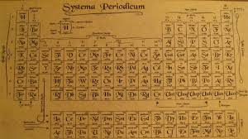

The Works of Dmìtrì Mendeleev
By Harry Long
8Y

Slide 2
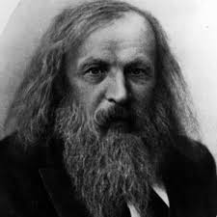
Life
Dmìtrì Mendeleev was son of Ivon Mendeleev and Maria Mendeleev. He was born in the village of Verknie Aremzyani in Siberia on 8 February 1834. It is unknown how many sibling he had, but his been estimated anywhere from 11 to 17 brothers and sisters. His father was a teacher and taught politics, fine arts and philosophy. However, because of the families financial state he became blind and unable to teach. At the age of 13 his father passed away his mothers glass factory’s destruction by fire.
Later on in life (August 1861) he published a book of his understandings of the Spectroscope. He also married Feozva Leshcheva on 27 April 1862. He became a professor at both Saint Petersburg Technological Institute and Saint Petersburg State University.
He died at the age of 72 in 1907. After his death several things were named after him, the crater Mendeleev on the moon, as well as the 101st element called Mendelivium.

Slide 3
Periodic T able
In the year of 1863 56 elements were known to man. At this point in time roughly one element was being discovered each year. "I saw in a dream a table where all elements fell into place as required. Awakening, I immediately wrote it down on a piece of paper, only in one place did a correction later seem necessary.“ Dmìtrì Mendeleev said this was how he created the Periodic table. He put them in order of atomic weight. His periodic table was vertical instead of the horizontal one we had today. However, he left gaps because he predicted more elements would be discovered. Using the atomic weights from surrounding elements he worked out what their atomic weights would be. Later on Gallium was discovered with a atomic weight of 70. Dmìtri said that it had an atomic mass of 68. He re-did his calculation to find he was correct. The founder of Gallium - Paul-Émile Lecoq de Boisbaudran announced later on that he himself did the incorrect calculation, furthermore the correct atomic weight was 68. So Dmìtrì had been even more accurate than the founder of Gallium and did all the calculations before it was found! Over the years more elements have been and there weren’t enough slot. It was turned sideways and more elements were added – this is our per iodic table. There was one element Dmìtrì didn’t except into the table and that was Radium. In 1898, Maria and Pierre Querie. One of Radiums property is that is can emit light. To emit light there must be a form of energy, and where is that energy coming from. An idea was that elements could become new element as they shed off energy and matter. However, many chemist disapproved of this theory, one of them being Dmìtrì. He believed that elements couldn’t be made, that was the point of the periodic table, everything was is were it should be, it was a system of organising the basics of our world.

Slide 4
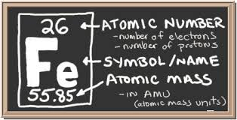
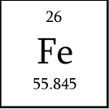
Symbols
Atomic Number – This number is the amount of protons in the atom.
Element Symbol – This is the elements name. This element is iron but it’s symbol is Fe. This is because the element’s symbol is written from the language the discoverer spoke. It was discovered by a ancient chemist who’s name is unknown. Scientist named in Fe after Ferrum meaning iron in Latin.
Atomic Mass – The quantity of smallest components that make it a chemical element.

Slide 5
References
Wikipedia.org
Bbc.com
http://study.com/academy/lesson/what-is-atomic-mass-definition-examples-quiz.html

