Slide 1
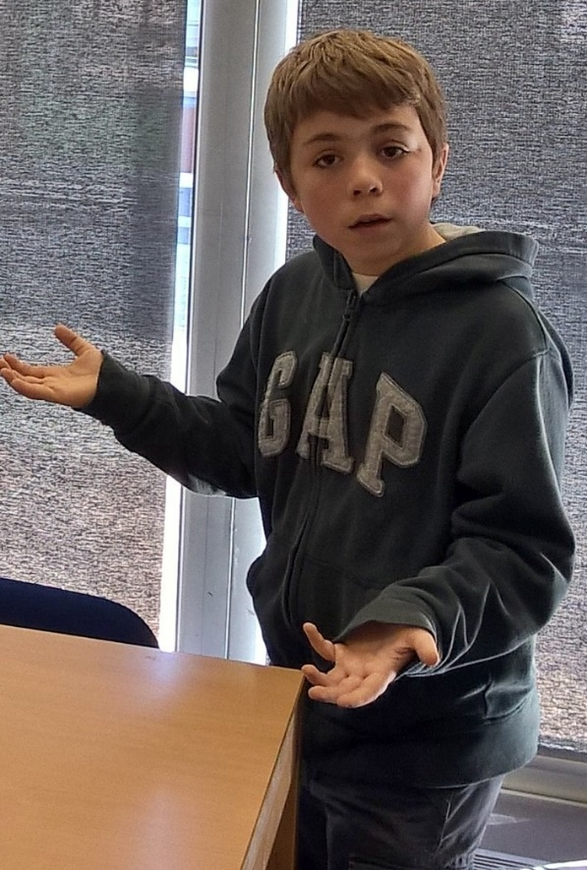
Bodies on Everest – Yes or No?
By Harry and William

Slide 2
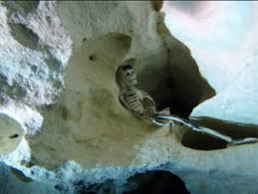
The Bodies Shall Stay
I believe the bodies should stay because otherwise we would be risking the lives of many trying to get them down and it would just did up the pain of loss for all the families of the climbers that are up there.
The air up there is too thin to do immense operations to uncover and send back down the bodies.
Some of the bodies would be unmovable even as they have become part of the mountain, frozen solid with ice like skin over a stitch. And bodies like this would have been frozen in this position.

Slide 3
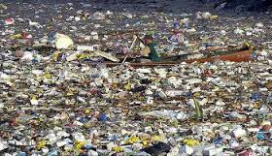
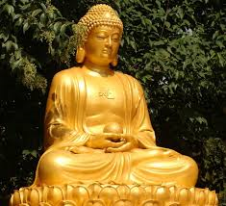
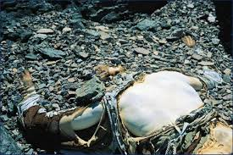
The Bodies Will Go!
They are polluting the mountain.
Everest will become the new pacific gyre with all the bodies and equipment up their.
We want to worship Mt. Everest and keep it clean and how Buddha created it.
It will scare off the tourists and then we won’t be able to help the mountain climbers and will make no money!!!
How can we worship the mountain if there are dead bodies on it!
Sherpas tend to get a little bit mad if you ruin the mountain!!!

Slide 4
R.I.P Sherpas

